Slide 1
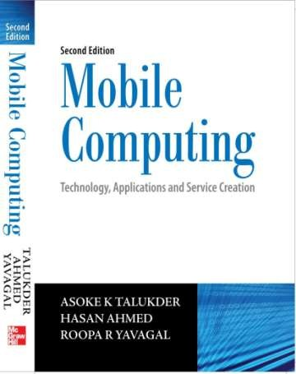
Mobile Computing
Chapter 2
Mobile Computing Architecture
Asoke K Talukder
Hasan Ahmed
© Tata McGraw Hill

Slide 2
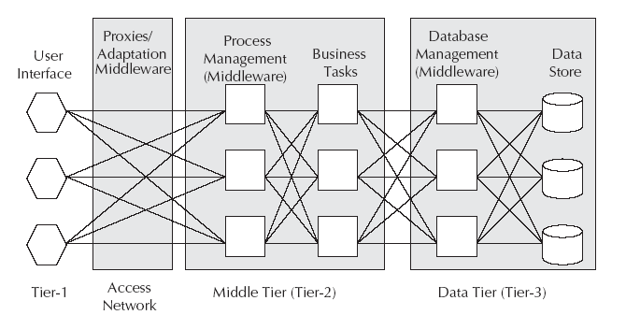
Architecture of Mobile Computing
The three tier architecture contains the user interface or the presentation tier, the process management or the application tier and the data management tier.

Slide 3
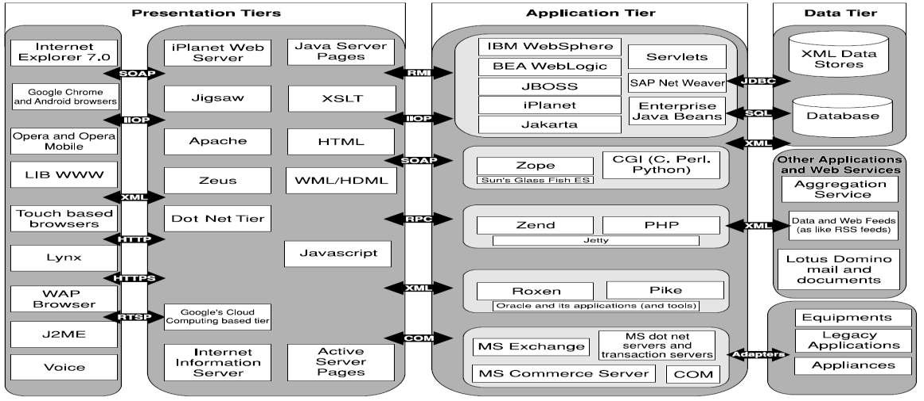
Mobile Computing Architecture

Slide 4
Presentation Tier
Responsible for presenting the information to the end user
Run on the client device and offer all the user interfaces
Includes web browsers, WAP browsers and client programs

Slide 5
Application Tier
Independent of presentation and database management
Handles functions related to middleware
Middleware – layer of software sitting between the operating system and user facing software
Many types of middleware – Message Oriented Middleware, Transaction Processing Middleware, Communication Middleware, Distributed Objects and Components, Transcoding Middleware, Web Services, etc.

Slide 6
Message Oriented Middleware
Loosely connects different applications through asynchronous exchange of messages
Works independent of platform or processor configuration
Generally asynchronous and peer to peer
Works in publish / subscribe fashion
Examples – MQ series from IBM, JMS, etc.

Slide 7
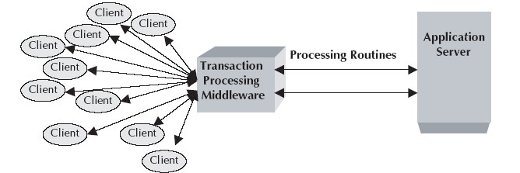
Transaction Processing Middleware
Provides tools and environment for developing transaction based distributed applications
Capable of providing services to thousands of clients in a
distributed client – server environment
Independent of database architecture
Example – CICS from IBM

Slide 8
Communication Middleware
Used to connect one application to another
Quite useful in the telecommunications world
Uses mediation server to automate the telnet protocol to communicate to nodes in the network
Example – Using telnet to connect one application to another

Slide 9
Distributed Objects and Components
Handles open distributed object computing infrastructure
Example – Common Object Request Broker Architecture (CORBA)
CORBA – a vendor independent infrastructure
CORBA – highly interoperable across heterogeneous platforms

Slide 10
Transcoding Middleware
Used to transcode one format of data to another suiting the needs
of the client
Useful for content adaptation to fit the needs of device
Example – Internet Content Adaptation Protocol (ICAP) from IETF

Slide 11
ICAP
Aimed at providing simple object based content vectoring for
HTTP services
Lightweight protocol to do transcoding on HTTP messages
Similar to executing a RPC on a HTTP request
Adapted messages can either be HTTP requests or HTTP responses

Slide 12
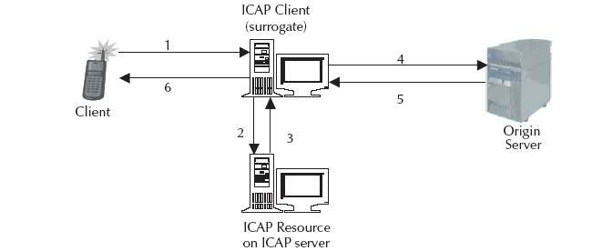
Data flow in an ICAP environment
A user agent makes a request to an ICAP-capable
surrogate (ICAP client) for an object on an origin server.
The surrogate sends the request to the ICAP server.
The ICAP server executes the ICAP resource’s service on the request and sends the possibly modified request, or a response to the request back to the ICAP client.
Continued…

Slide 13
The surrogate sends the request, possibly different from the original client request, to the origin server.
The origin server responds to the request.
The surrogate sends the reply (from either the ICAP server or the origin server) to the client.

Slide 14
Web Services
Provides a standard means of communication and information exchange among different software applications
Public interfaces and bindings are defined using XML
Standards for service requestor and service provider
Service requestor – find and discover the description of services
Service provider – publish the description of services it provides

Slide 15
Data Tier
Used to store data needed by the application and acts as a repository for both temporary and permanent data
Can use XML for interoperability of data with other systems and data sources
Might incorporate the use of Database Middleware and SyncML
Database Middleware – interfaces application programs and the database
Database Middleware – helps business logic run independent and transparent from database technology and database vendor

Slide 16
SyncML
Emerging standard for synchronization of data access from different nodes
Promotes a single common data synchronization protocol that can be used industry wide
Supports naming and identification of records and common protocol commands to synchronize local and network data
Works over all networks used by mobile devices – wired and wireless

Slide 17
Design Considerations
Context information is the information related to the surrounding environment of an actor in that environment.
Mobility implies that attributes associated with devices and
users will change constantly.
Such changes shall mean that content and behavior of applications should be adapted to suit the current situation.
Some examples are:
Content with context awareness
Content switch on context
Content transcoding on context

Slide 18
Concerning contexts in Mobile Computing
The following contexts need to be taken care of:
User context
Device context
Network context
Bandwidth context
Location context
Time context
Environment context
Charging context
Security context

Slide 19
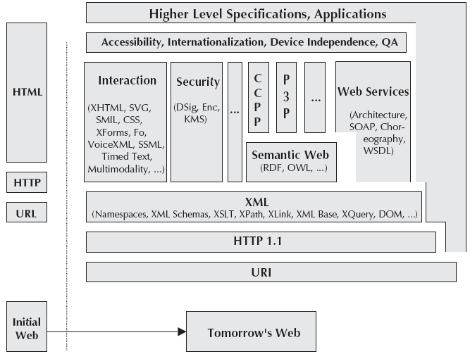
Content architecture in Mobile Computing

Slide 20
Client Context Manager (CCM)
Maintains information pertaining to:
Mobile devices
Users
Location
Network
Environment around each mobile device

Slide 21
Challenges with CCM
Context definition: Defining context attributes with interoperability in mind; how will every GPS device know the current data format?
Context sensing: The way context data is obtained; e.g. GPS data acquisition
Context representation: The way context information is stored and transported; e.g. transmitting such information
Context interpretation: The way the context data is interpreted; e.g. we might need additional GIS information to interpret the GPS data

Slide 22
Contexts handled by CCM
Identity
Spatial and temporal information
Environmental information
Social information
Proximity and availability of resources
Physiological measurements
Activity
Schedules and agendas

Slide 23
Functions of the CCM
Responsible for receiving raw context data, collating the data into a useful form and disseminating it to context consumers.
Present context information to consumers in suitable and interoperable form.
Context model should allow aggregation.
Dynamic updates should be possible.
Context history should be available.
Context should be filtered.

Slide 24
Composite Capabilities/Preference Profiles
Proposed W3C standard for describing device capabilities and user preferences
Based on Resource Description framework (RDF)
Can be serialized using XML
Origin server or proxy can perform some sort of content to
device matching
Abbreviated as CC/PP

Slide 25
CC/PP in action
Device sends serialized profile model with request for content.
Origin server receives serialized RDF profile and converts it into an in – memory model.
The profile for the requested document is retrieved and an in – memory model is created.
The device profile model is matched against the document profile model.
A suitable representation of the document is chosen. Either content switch on context or content transcoding on context is employed.
Document is returned to device and presented.

Slide 26
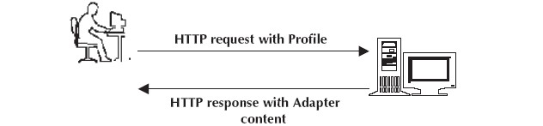
Simplest use of CC/PP

Slide 27
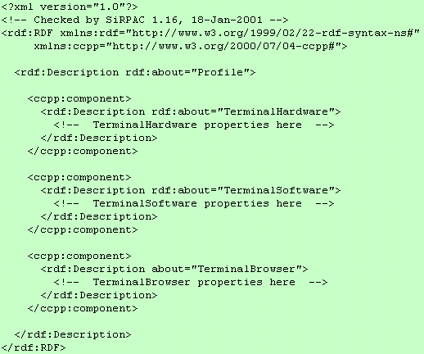
Format for RDF

Slide 28
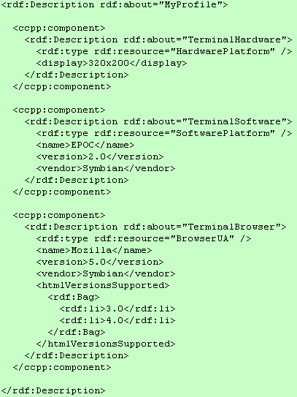
Example for RDF

Slide 29
Parser for RDF
Java based RDF parser (SiRPAC) is available free on the web.
SiRPAC can be used to parse serialised RDF into triples.
Triples are the output of RDF parsers and are of the form triple (subject, predicate, object).
Using triples, it is possible to build a CC/PP model. The model is updated whenever new context data are sent from context sources.

Slide 30
Policy Manager
Responsible for controlling policies related to mobility
Should be able to define policy for documents/services and assign roles to user
Should assign roles to users like
Permission
Prohibition
Obligations
Policy combined with context should determine
what action(s) the user is allowed to perform?
what action(s) the user is obliged to perform?
the policy applicable

Slide 31
Semantic Web
Facilitates putting machine understandable data on the web
Facilitates web definition and linking in a way to be useful for machines in the context of automation, security, filtering, integration and data reuse
Increases the modularity of web applications
Built on syntaxes which use URI’s to represent data
Such syntaxes are called Resource Description Framework (RDF) syntaxes

Slide 32
Security Manager
Secures connection between client device and origin server
Should handle
Confidentiality (managed by encryption)
Integrity (managed by algorithms)
Availability (relates to peripheral security)
Non – repudiation (managed by digital signatures)

Slide 33
Platform for Privacy Preference Project
Emerging standard defined by W3C
Enables websites to express their privacy practices in a
standardized format retrievable and interpretable by user agents
Any discrepancies between a site’s practices and the user preferences can be flagged as well
Does not provide any mechanism for ensuring that websites act according to their policies
Intended to be complementary to both legislative and self– regulatory programmes

Slide 34
Adaptability Manager
Based on context and policy , it should adapt to:
Content
Behaviour
Other aspects
May take any number of actions depending upon the information passed to it by Context Manager
May include appending location – specific information to documents

Slide 35
Content adaptation
Content should be able to adapt to dynamic situations.
Adaptation can be static or dynamic.
Content adaptation can be performed either at content level in server or agent level in client.
Content adaptation can be handled by middleware as well.
Content adaptation needs to consider the physical and logical capabilities of the device, effective network bandwidth and payload (total number of bits delivered to the agent for static parts).

Slide 36
Content transcoding
The resource requirements for the client devices can be determined by:
Static content size in bits
Display size
Streaming bit rate
Colour requirements
Compression formats
Hardware requirements

Slide 37
Types of content transcoding
Spatial transcoding
Temporal transcoding
Colour transcoding
Code transcoding
Object or semantic transcoding

Slide 38
Content rating and filtering
Need to ensure social discipline in the electronic world
Platform for Internet Content Selection (PICS)
PICS – W3C proposed standard for web content rating
PICS – set of technical specifications for labels that help software and rating services to work synergistically
PICS – services should choose their own criteria for proper identification and filtering of content
Rating can be though self labeling or third party labeling
Originally designed to help parents and teachers control children access to the Internet
Also includes code signing and privacy

Slide 39
RSACI
Acronym for Recreational Software Advisory Council – Internet
Has a PICS compliant rating system called Resaca
Resaca has four categories – violence, nudity, sex and language
Has a rating range from 0 to 4
0 means no potentially offensive content
4 means highest level of offensive content
PICS – a general meta data system
PICS labels – helpful in finding desirable content on the web
PICS – enables more sophisticated commerce, communication, indexing and searching services

Slide 40
Content Aggregation
From the content aggregator’s perspective, services are of two categories:
Single service request – works at user level and for one user
Example : A user may request a webpage in Hindi from proxy server. Here, the user buys both the content and translation service.
Group service request – works for a group of users
Example : The content aggregator has some arrangement for advertisement. It examines all HTML pages and inserts an advertisement at an appropriate place.

Slide 41
Seamless Communication
A ubiquitous system involves availability and accessibility from anywhere, anytime and through any network or device.
Seamless communication shall involve seamless handovers and seamless roaming.
Handoff is the process by which the connection to the network is moved from one base station to another within the same network without discontinuing the service.
Roaming shall involve the point of attachment moving from one base station of one network to a base station of another network.

Slide 42
Aspects of Seamless Communication
Authentication across network boundaries
Authorization across network boundaries
Billing and charging data collection
End – to – end data security across roaming
Handoff between wireless access points
Roaming between networks
Session migration
IP mobility

Slide 43
Autonomous Computing
The purpose of autonomous computing is to free users and system administrators from the details of the system operation and maintenance complexity. It combines the following functions:
Self configurable
Self optimizing
Self healing
Self protecting
Self upgradable

Slide 44
Context aware systems
The following information needs to be handled in a mobile computing environment for making a system context aware:
Location information
Device information
Network information
User information
Environment information

Slide 45
Global Positioning System
Gives the exact positioning on Earth
Funded and controlled by US Department of Defense
Has three parts – the space segment, the user segment and control segment.
Has 24 satellites , each in its own orbit 11,000 nautical miles
above Earth.

